Slide 1

CIRCOS
Pradyumna J

Slide 2
What is Circos?
Genomic visualization tool created by Martin Kryzywinski.
Represent data in circular layout.
Can represent most of biological data (copy number, methylation, relation between genomes/ genes etc.)
Circos can adjust the visualization based on data values
Ideally suited for imaging relationship between positional data
By compositing the axes circularly, instead of along straight lines, relationship views become less cluttered
Circos does not perform any analysis

Slide 3
Circos can be easily automated and incorporated into data analysis pipelines
Circos does not have an interactive interface
Circos is written in Perl, which is available for nearly any computing platform.
Available at http://circos.ca

Slide 4
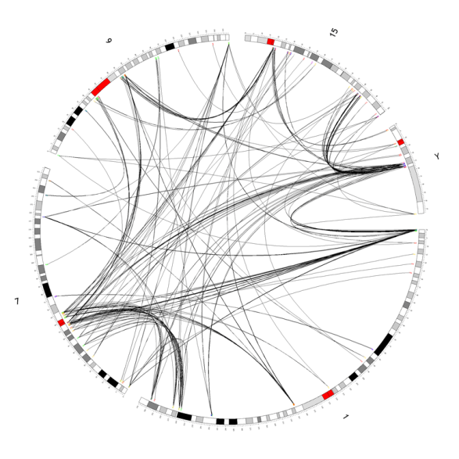
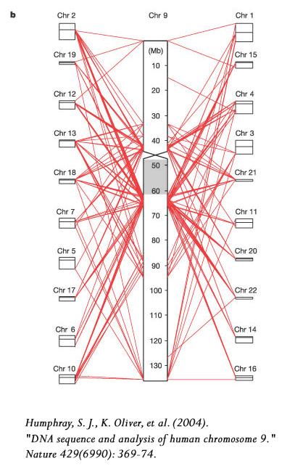
Why Circos?

Slide 5
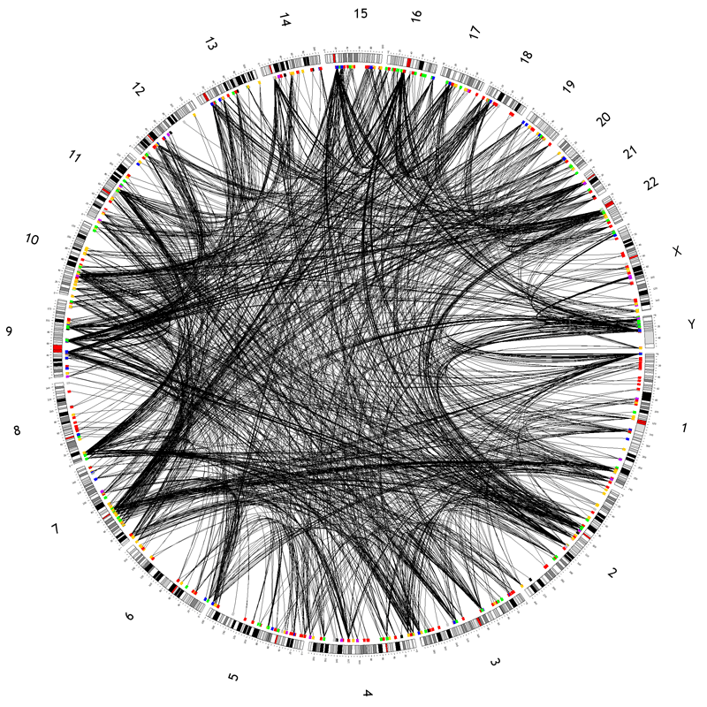
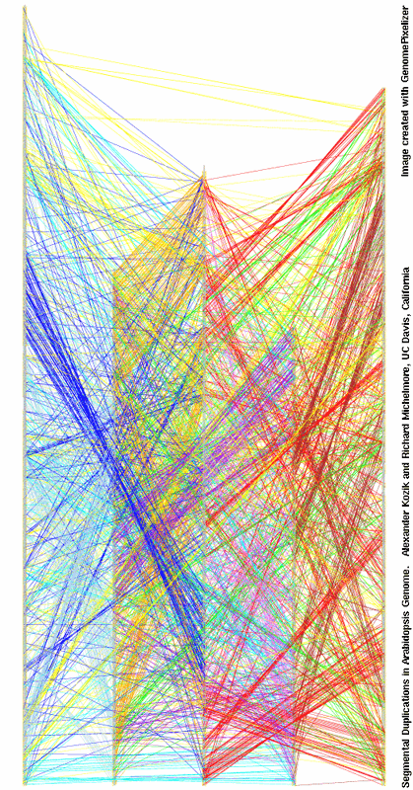
Why Circos?

Slide 6
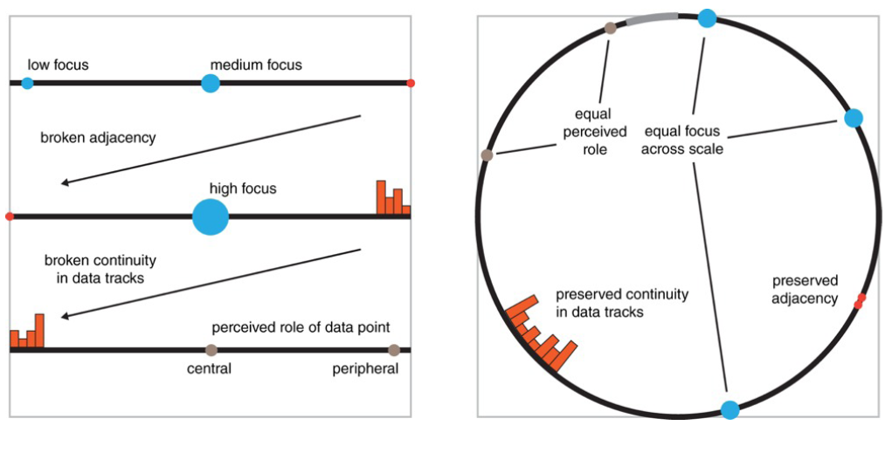
Why Circos?
Notes:
Linear layout of scale has disadvantages of changing focus (regions in the center of the image receive more attention),
broken adjacency (neighbouring points
on a linear scale are separated), broken continuity (data tracks are difficult to follow from one edge of the figure to another),
and non-uniform data emphasis
(center and edge of the axis are not perceived uniformly - the edge implies periphery, which may not apply.
6

Slide 7
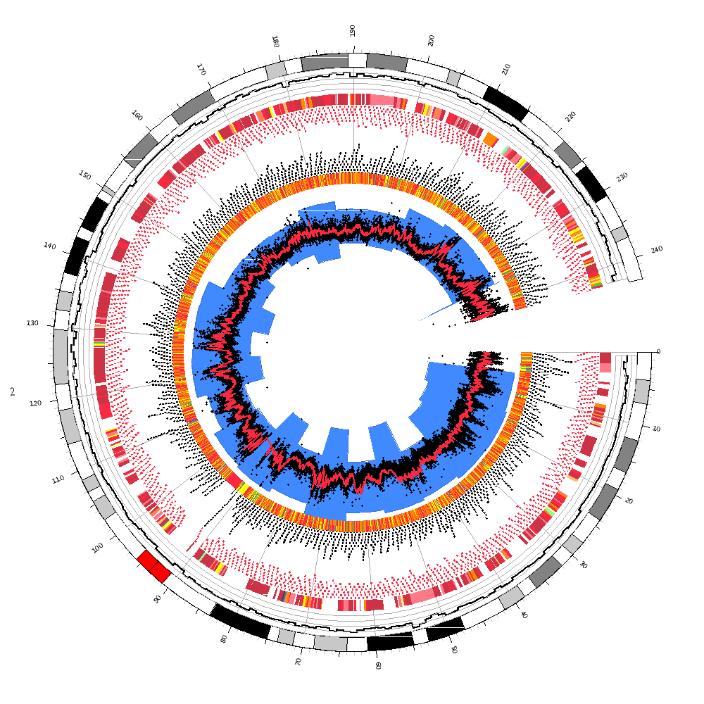
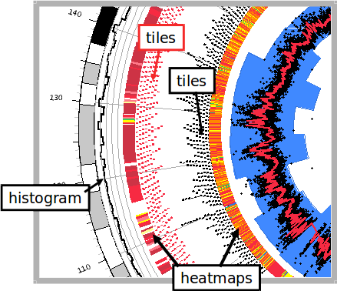

Slide 8
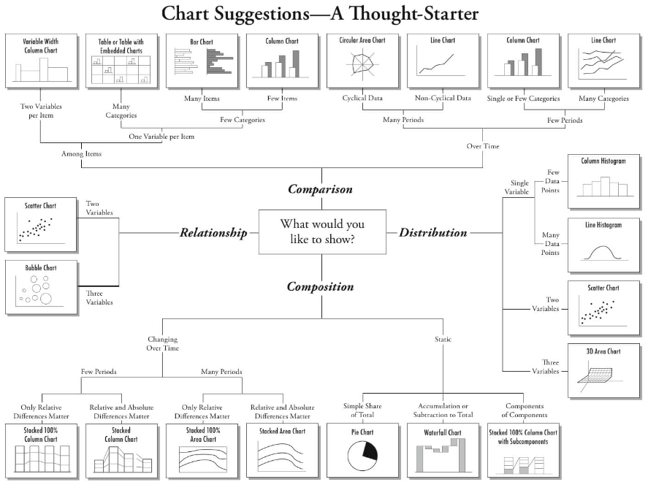

Slide 9
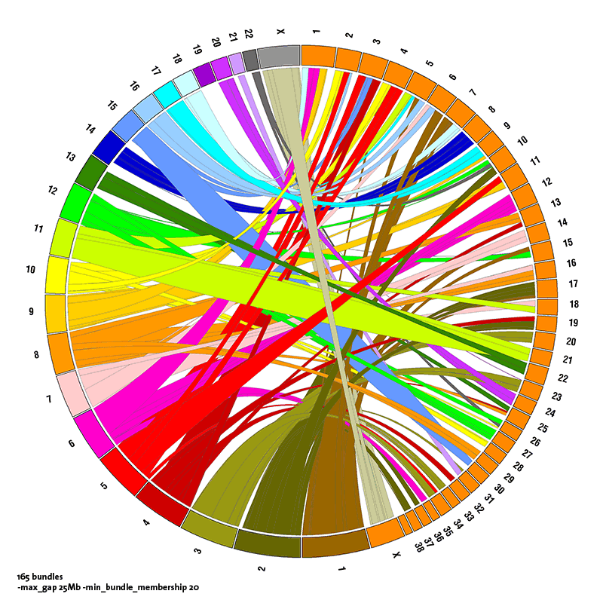
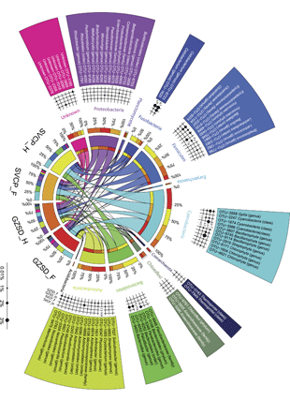
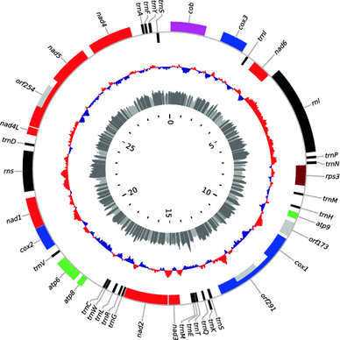
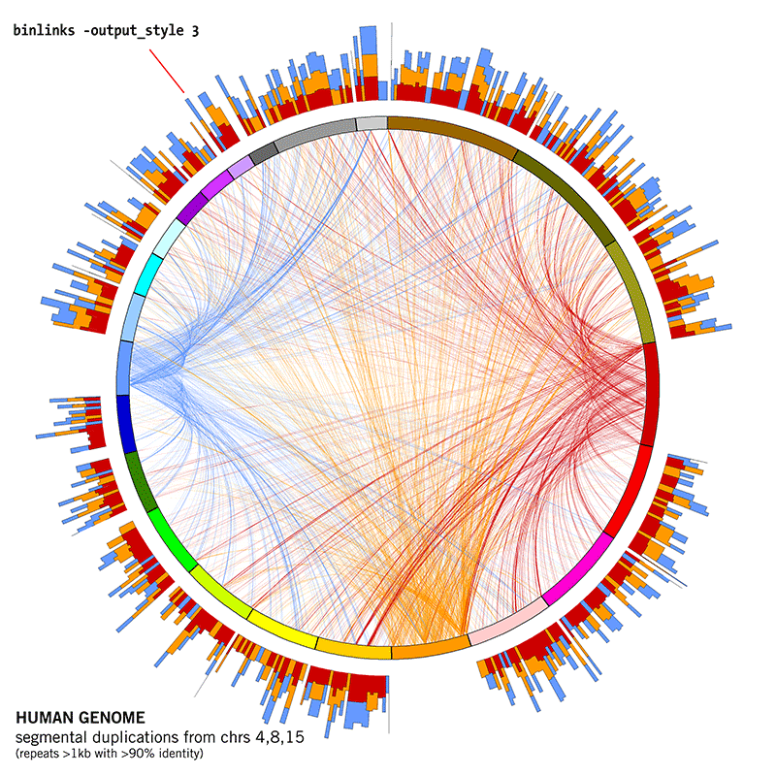

Slide 10
Circos File Structure
circos-0.69/
├── bands.conf
├── bin
│ ├── circos
│ ├── gddiag
│ ├── list.modules
│ └── test.modules
├── circos.conf
├── data
│ └── karyotype
│ ├── karyotype.human.hg19.txt
│ └── karyotype.human.hg38.txt
├── errors
├── etc
├── fonts
├── ideogram.conf
├── ideogram.label.conf
├── ideogram.position.conf
├── input1.txt
├── input2.txt
├── lib
├── README
├── README.tutorials
├── SUPPORT
├── ticks.conf
├── tiles
└── toget
Circos script
Main configuration file
Karyotype Definition
Settings
Ideogram configuration file
Data files
Ticks Configuration file

Slide 11
Circos File Structure
Chromosomes and ideograms:
Ideograms refer to graphical representations of chromosomes or the region of chromosome.
default ideograms are arranged in a circle but radial positions of individual ideograms can be changed
<ideogram>
<spacing>
default = 0.005r
</spacing>
radius = 0.90r
thickness = 20p
fill = yes
stroke_color = dgrey
stroke_thickness = 2p
show_label = yes
label_font = default
label_radius = dims(image,radius)-60p
label_size = 30
label_parallel = yes
</ideogram>
Ideograms are drawn based on a karyotype file which defines the name, size and label of all chromosomes in the data set.

Slide 12
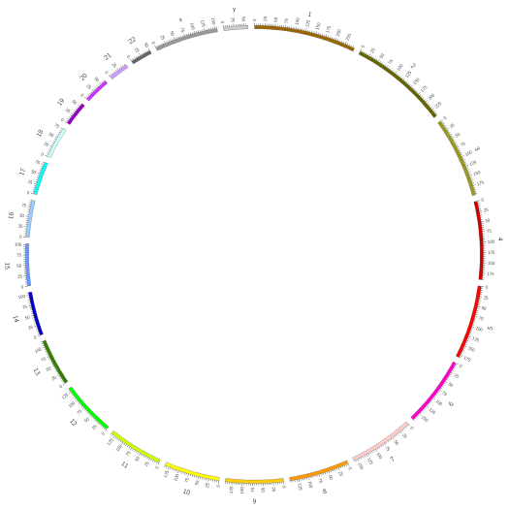
Config file:
Hierarchical with parameters stored in blocks
karyotype = karyotype.human.hg19.txt
chromosomes_units = 1000000
<<include ideogram.conf>>
<<include ticks.conf>>
<image>
<<include etc/image.conf>>
</image>
<<include etc/colors_fonts_patterns.conf>>
<<include etc/housekeeping.conf>>

Slide 13
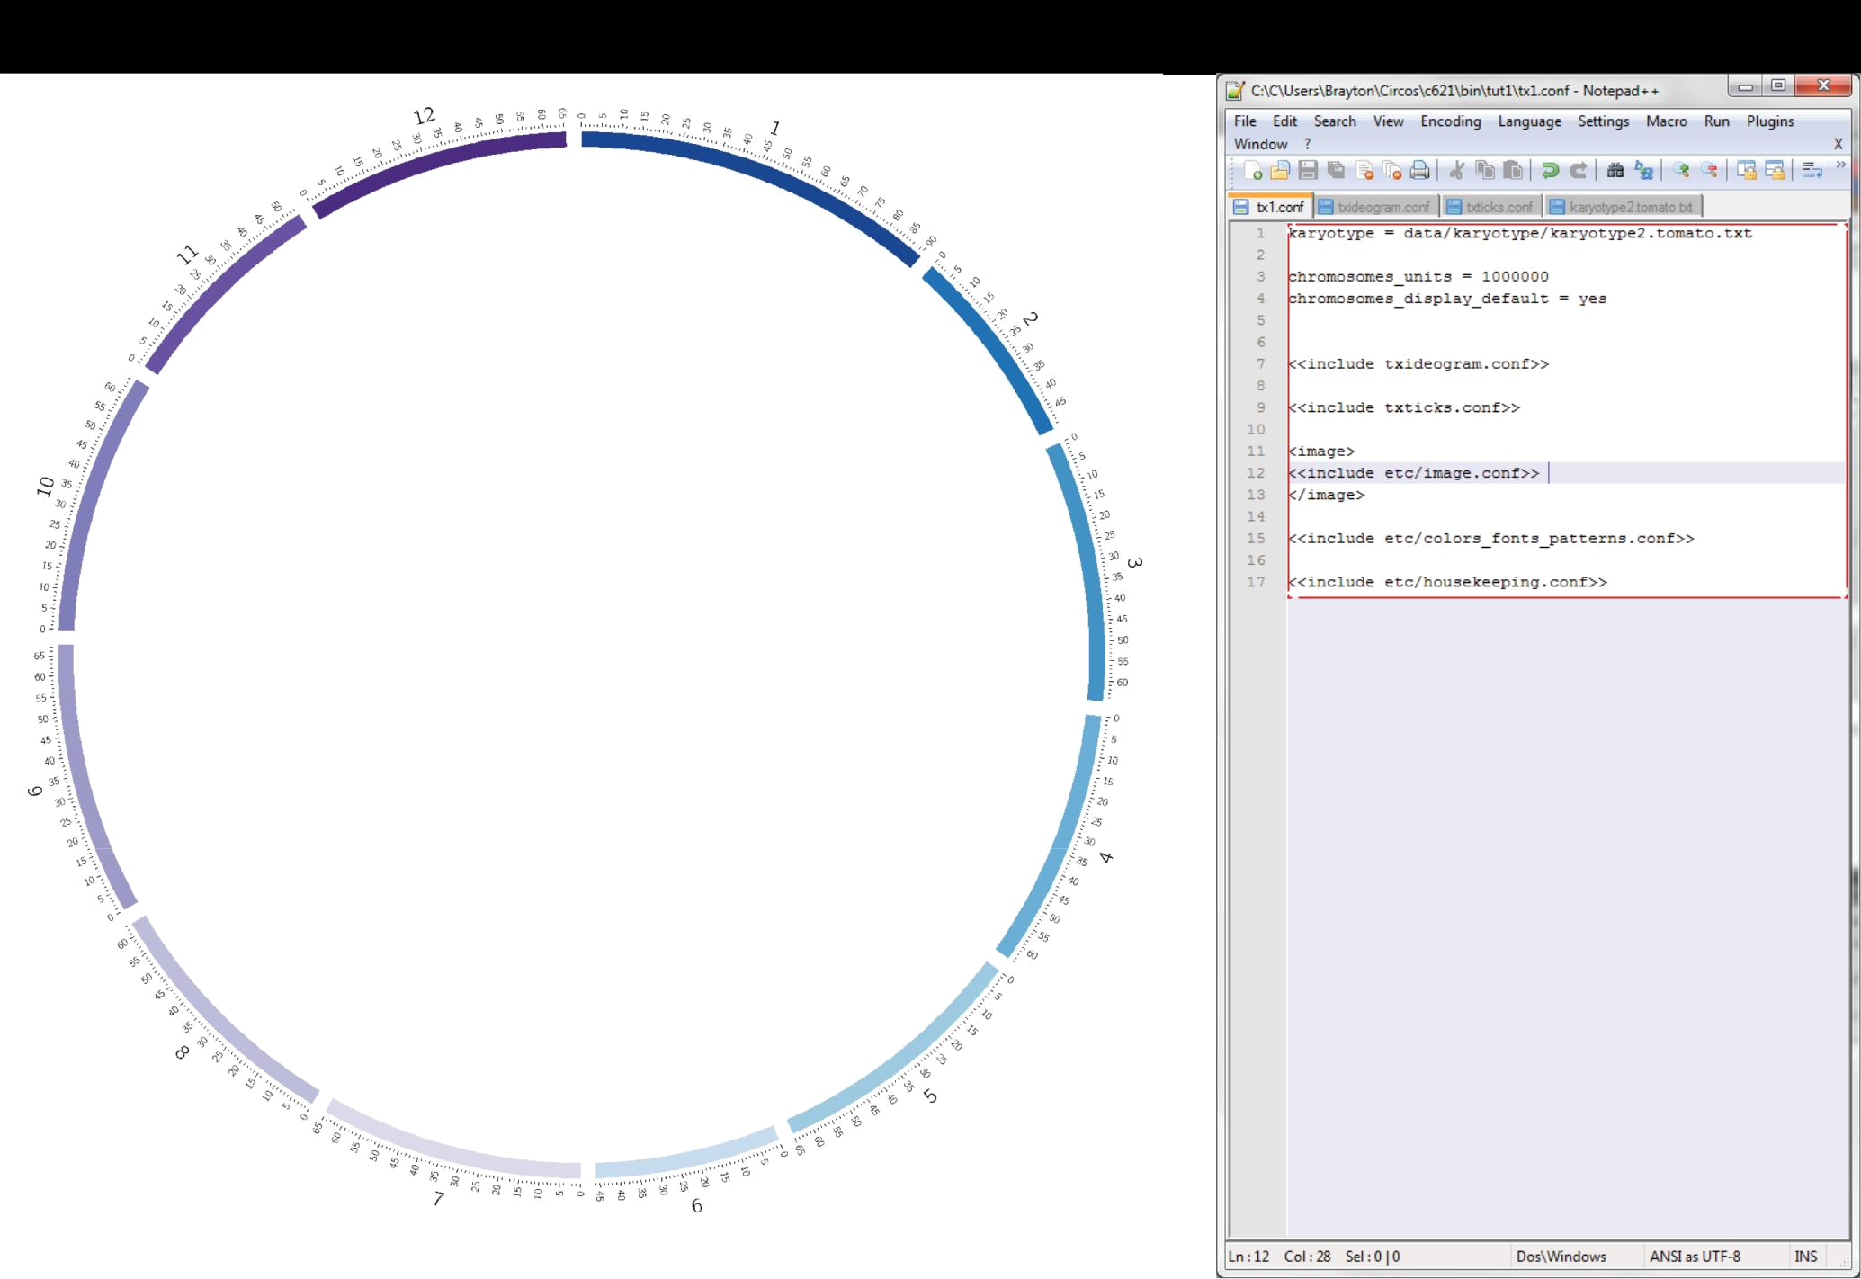
Notes:
This is the basic file format of a Circos image.
The main configuration file contains a reference file for the karyotype information, information about the chromosome scale, reference files for ideogram and tick mark display (these are separate files to keep the main .conf file manageable),
Units You can make circos images measured in megabases or centimorgans chromosome_units – in the main configuration file, this specifies the value for the abbreviation ‘u’. Since basepair values are typically many millions, u can be used to shorten the notation in configuration files.
13

Slide 14
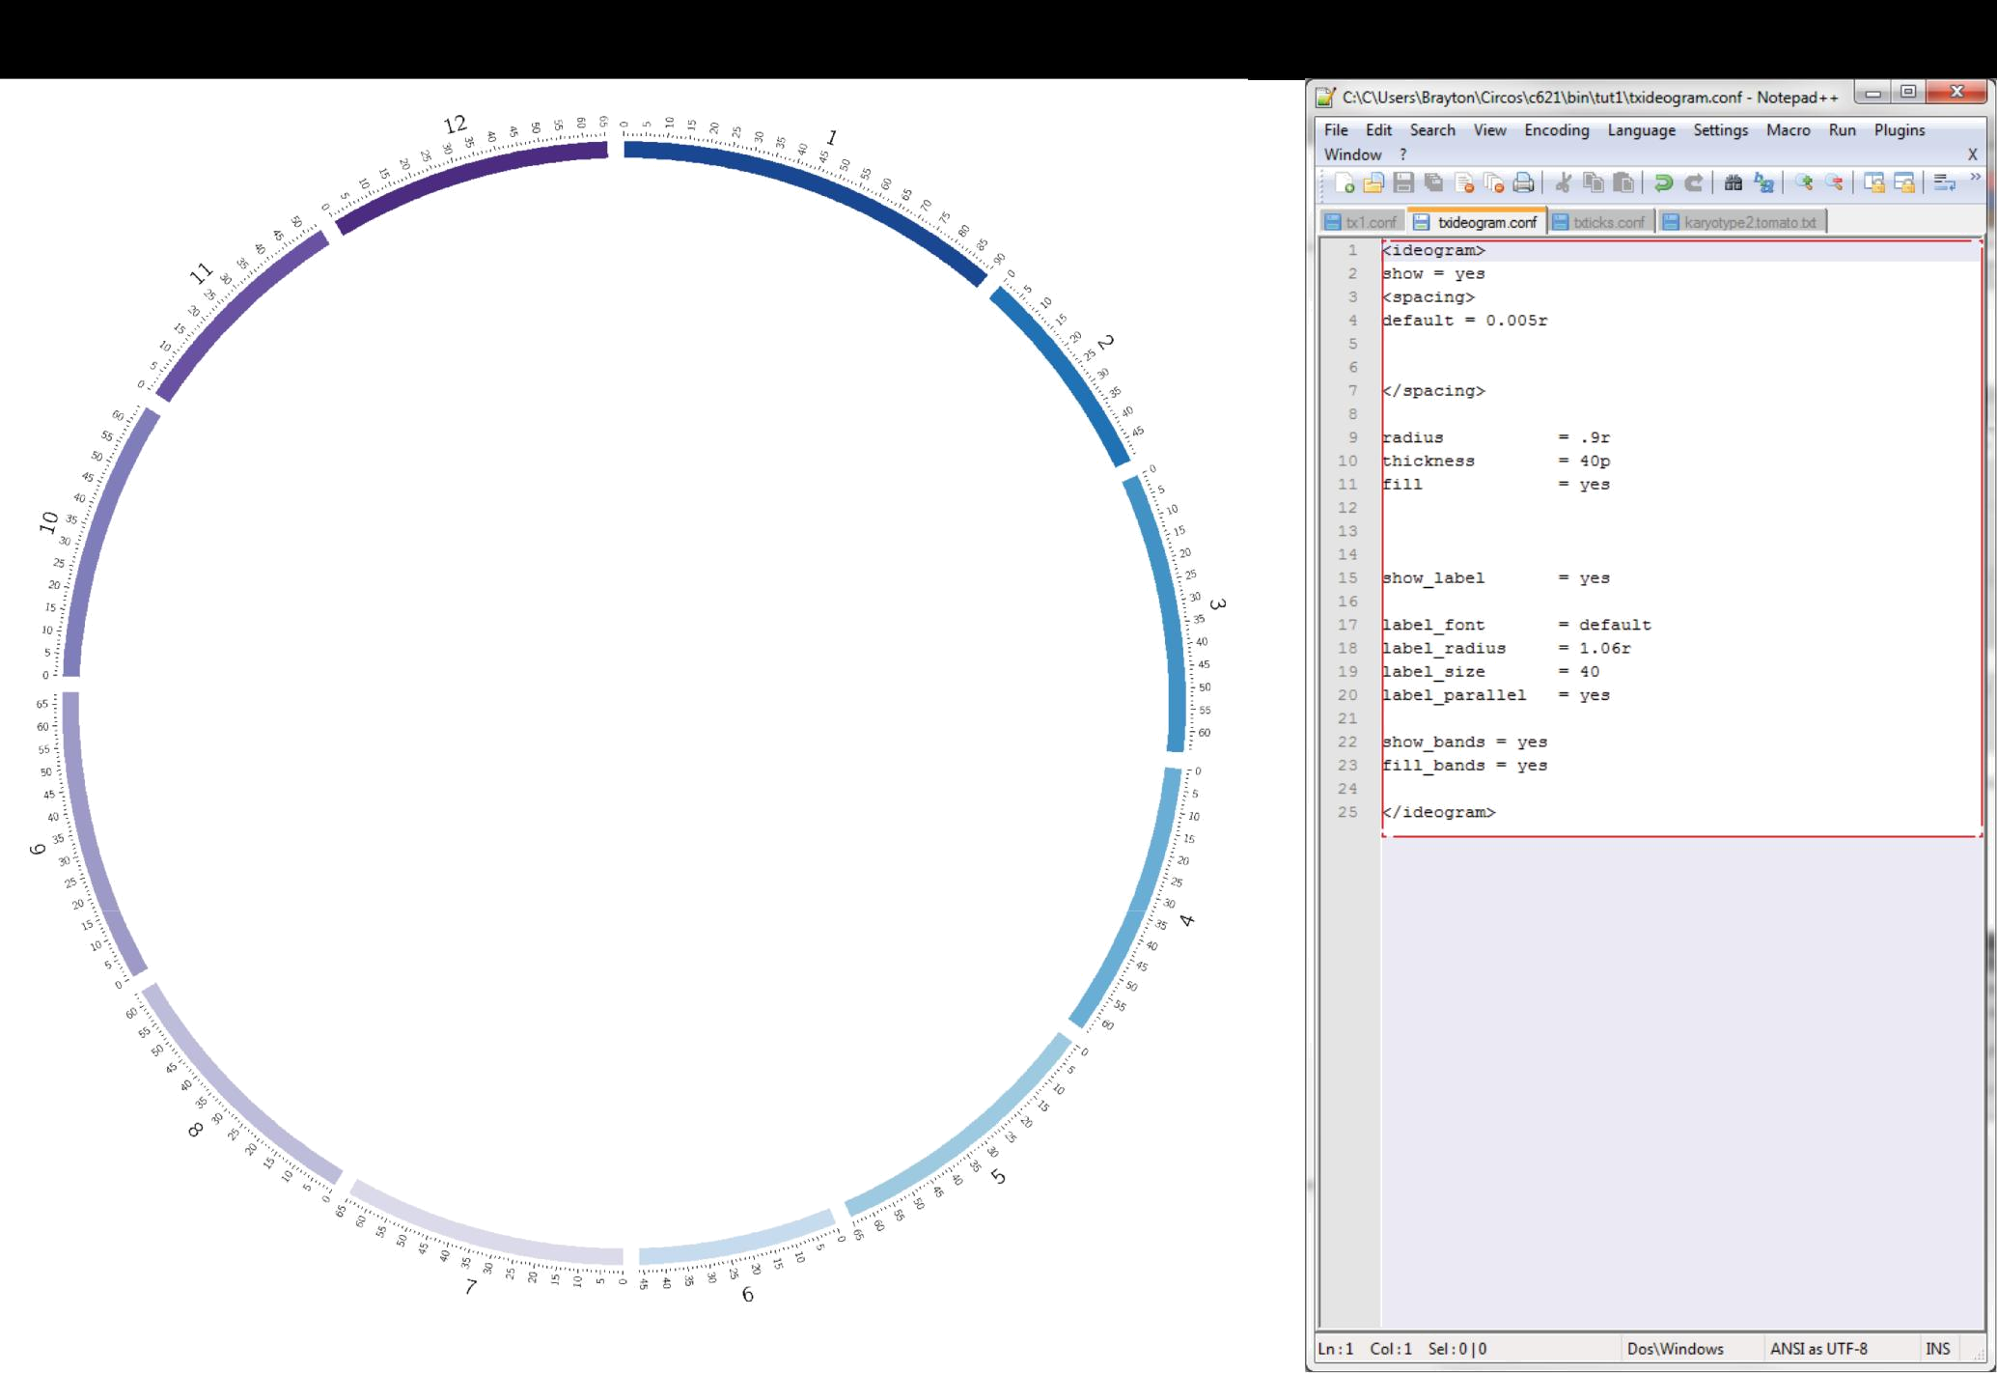
Notes:
Ideograms (the blue bands in the image) are a representation of each chromosome.
They can be turned on or off, but their position and formatting information is still required in every main configuration file.
Banding information can be displayed on the ideograms as well.
The position of the ideograms is very important as it is the reference for all labels, data tracks and links in the image.
14

Slide 15
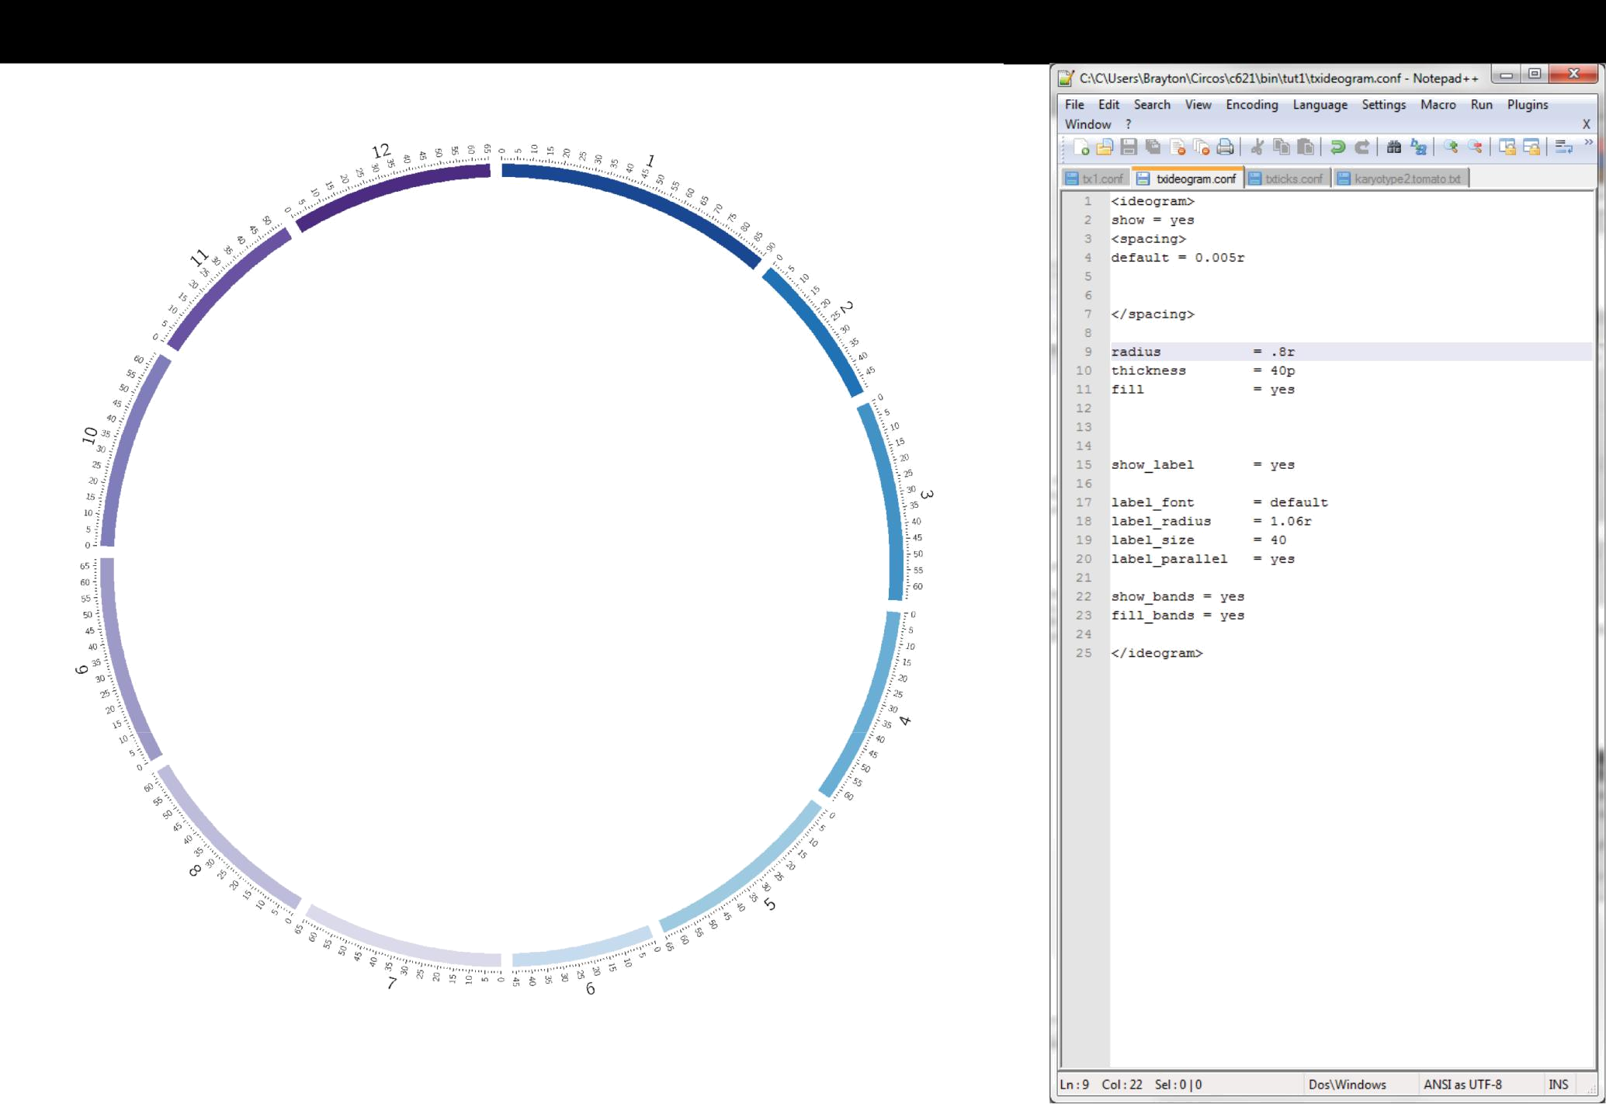
Notes:
Change in radius
15

Slide 16
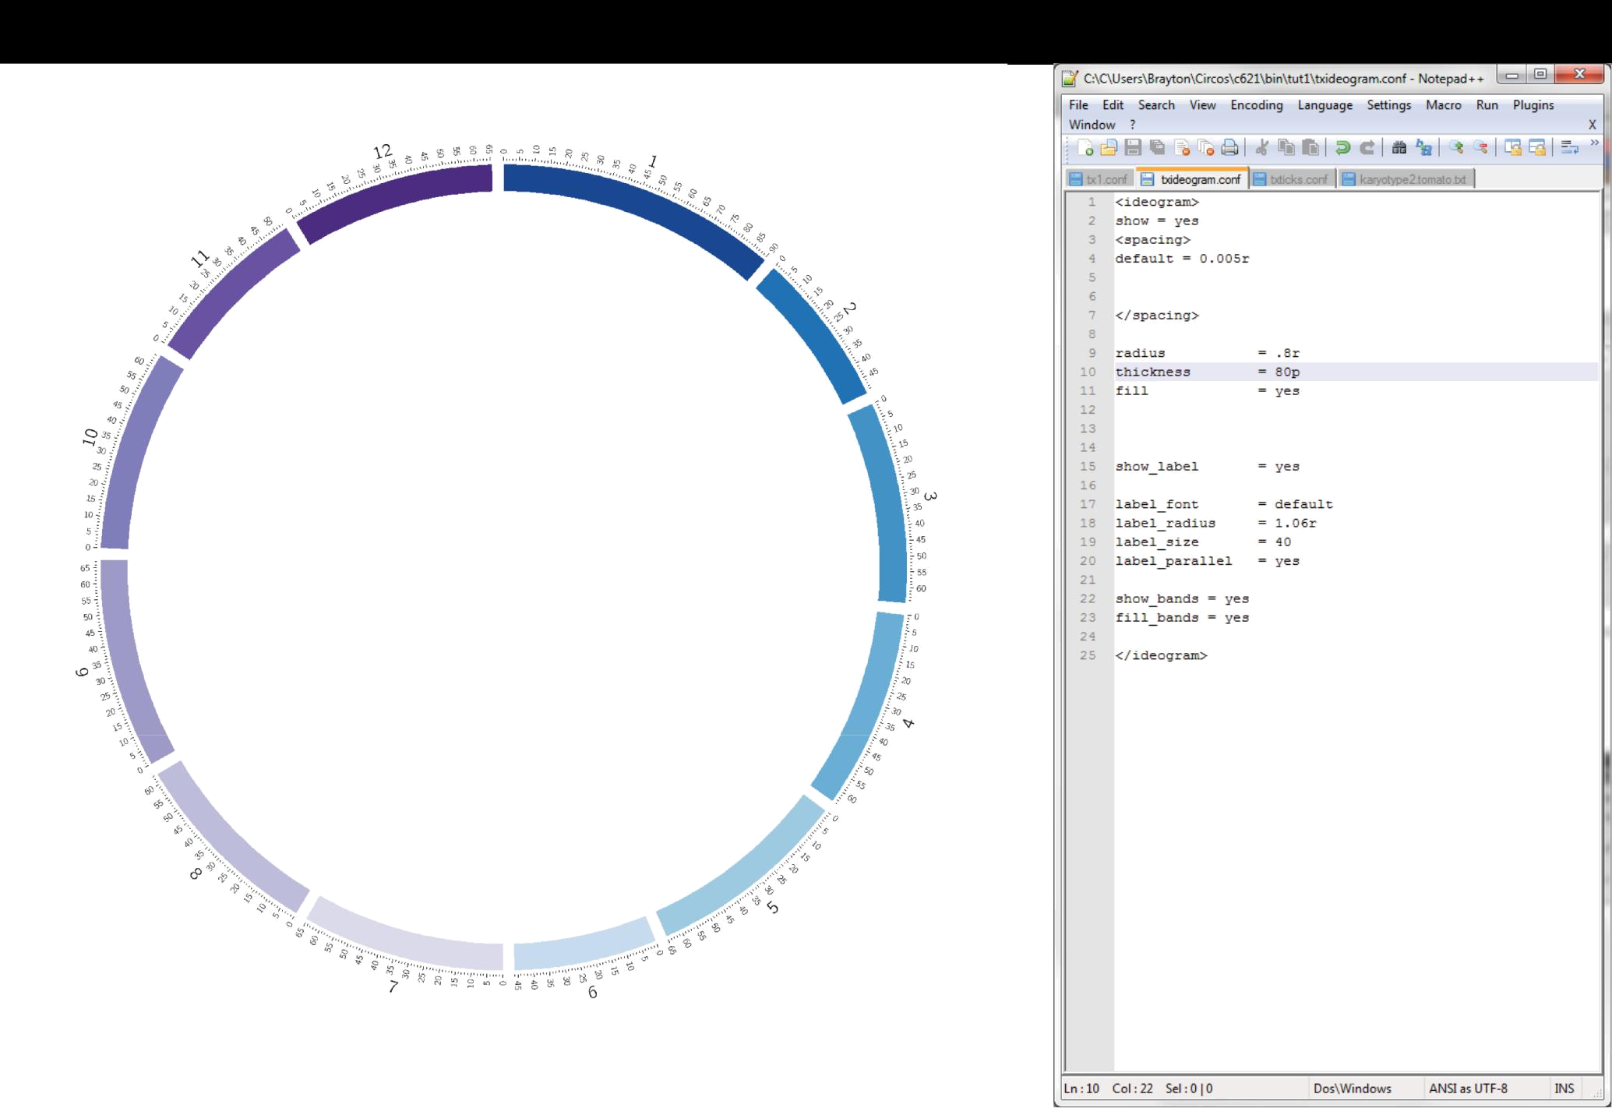
Notes:
Change in the thickness
16

Slide 17

Notes:
Lable radius
17

Slide 18

Notes:
Label size of chr
18

Slide 19
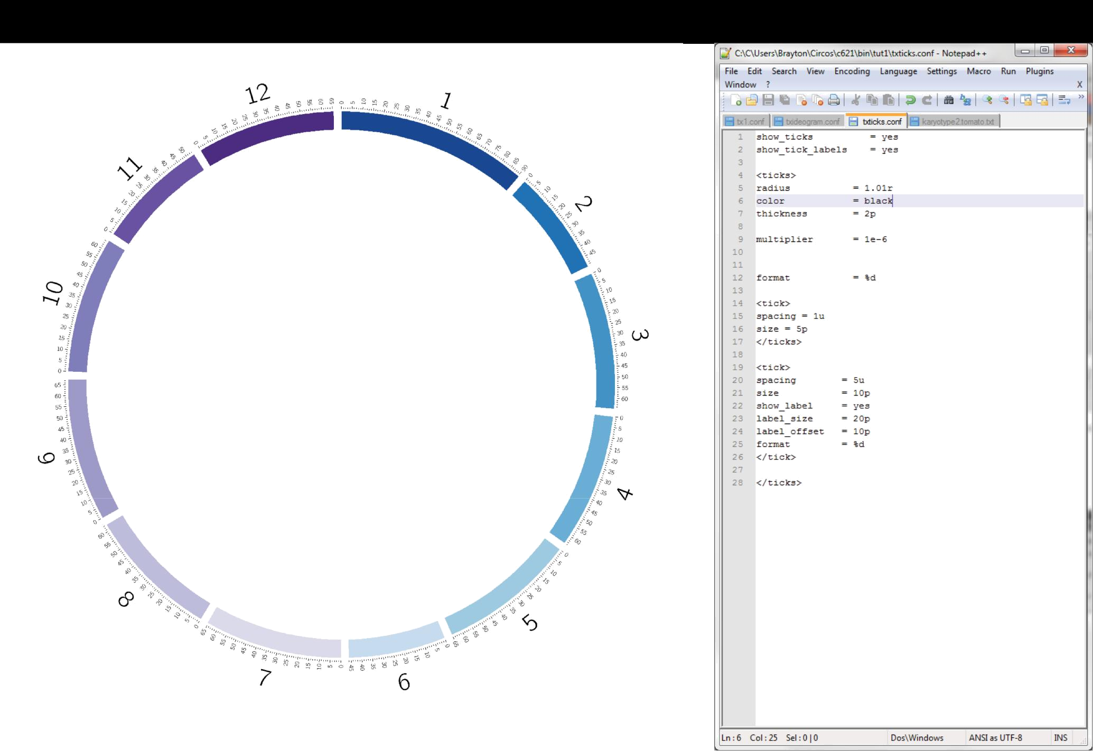
Notes:
color
19

Slide 20


Slide 21
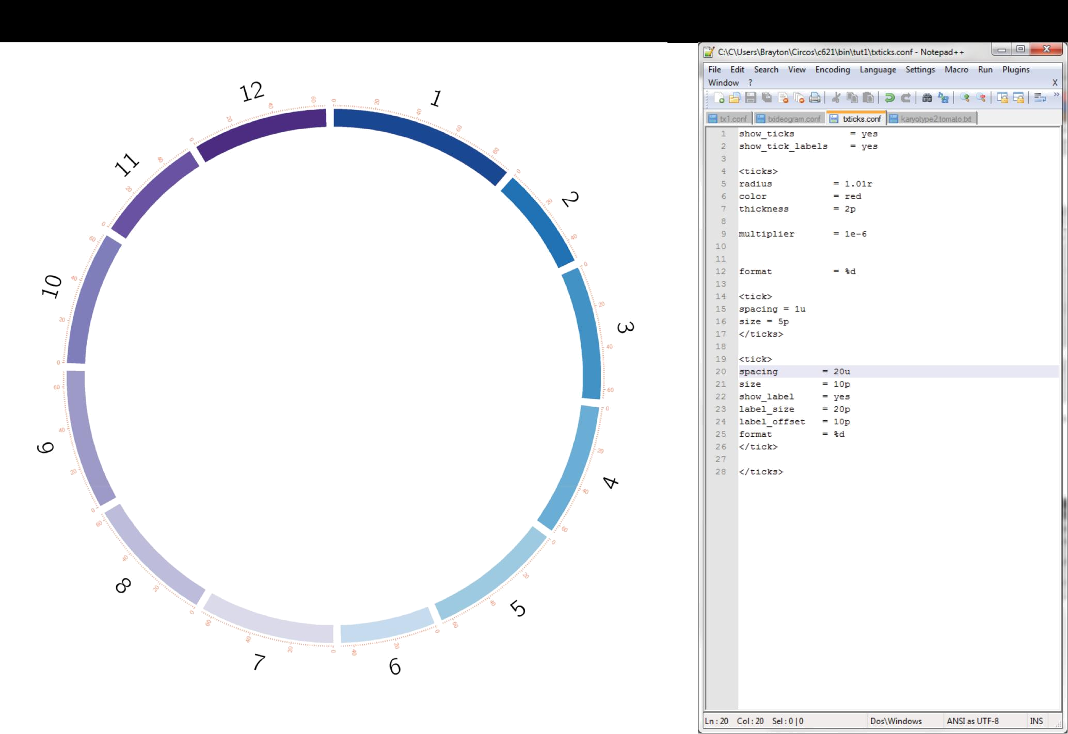
Notes:
color
21

Slide 22
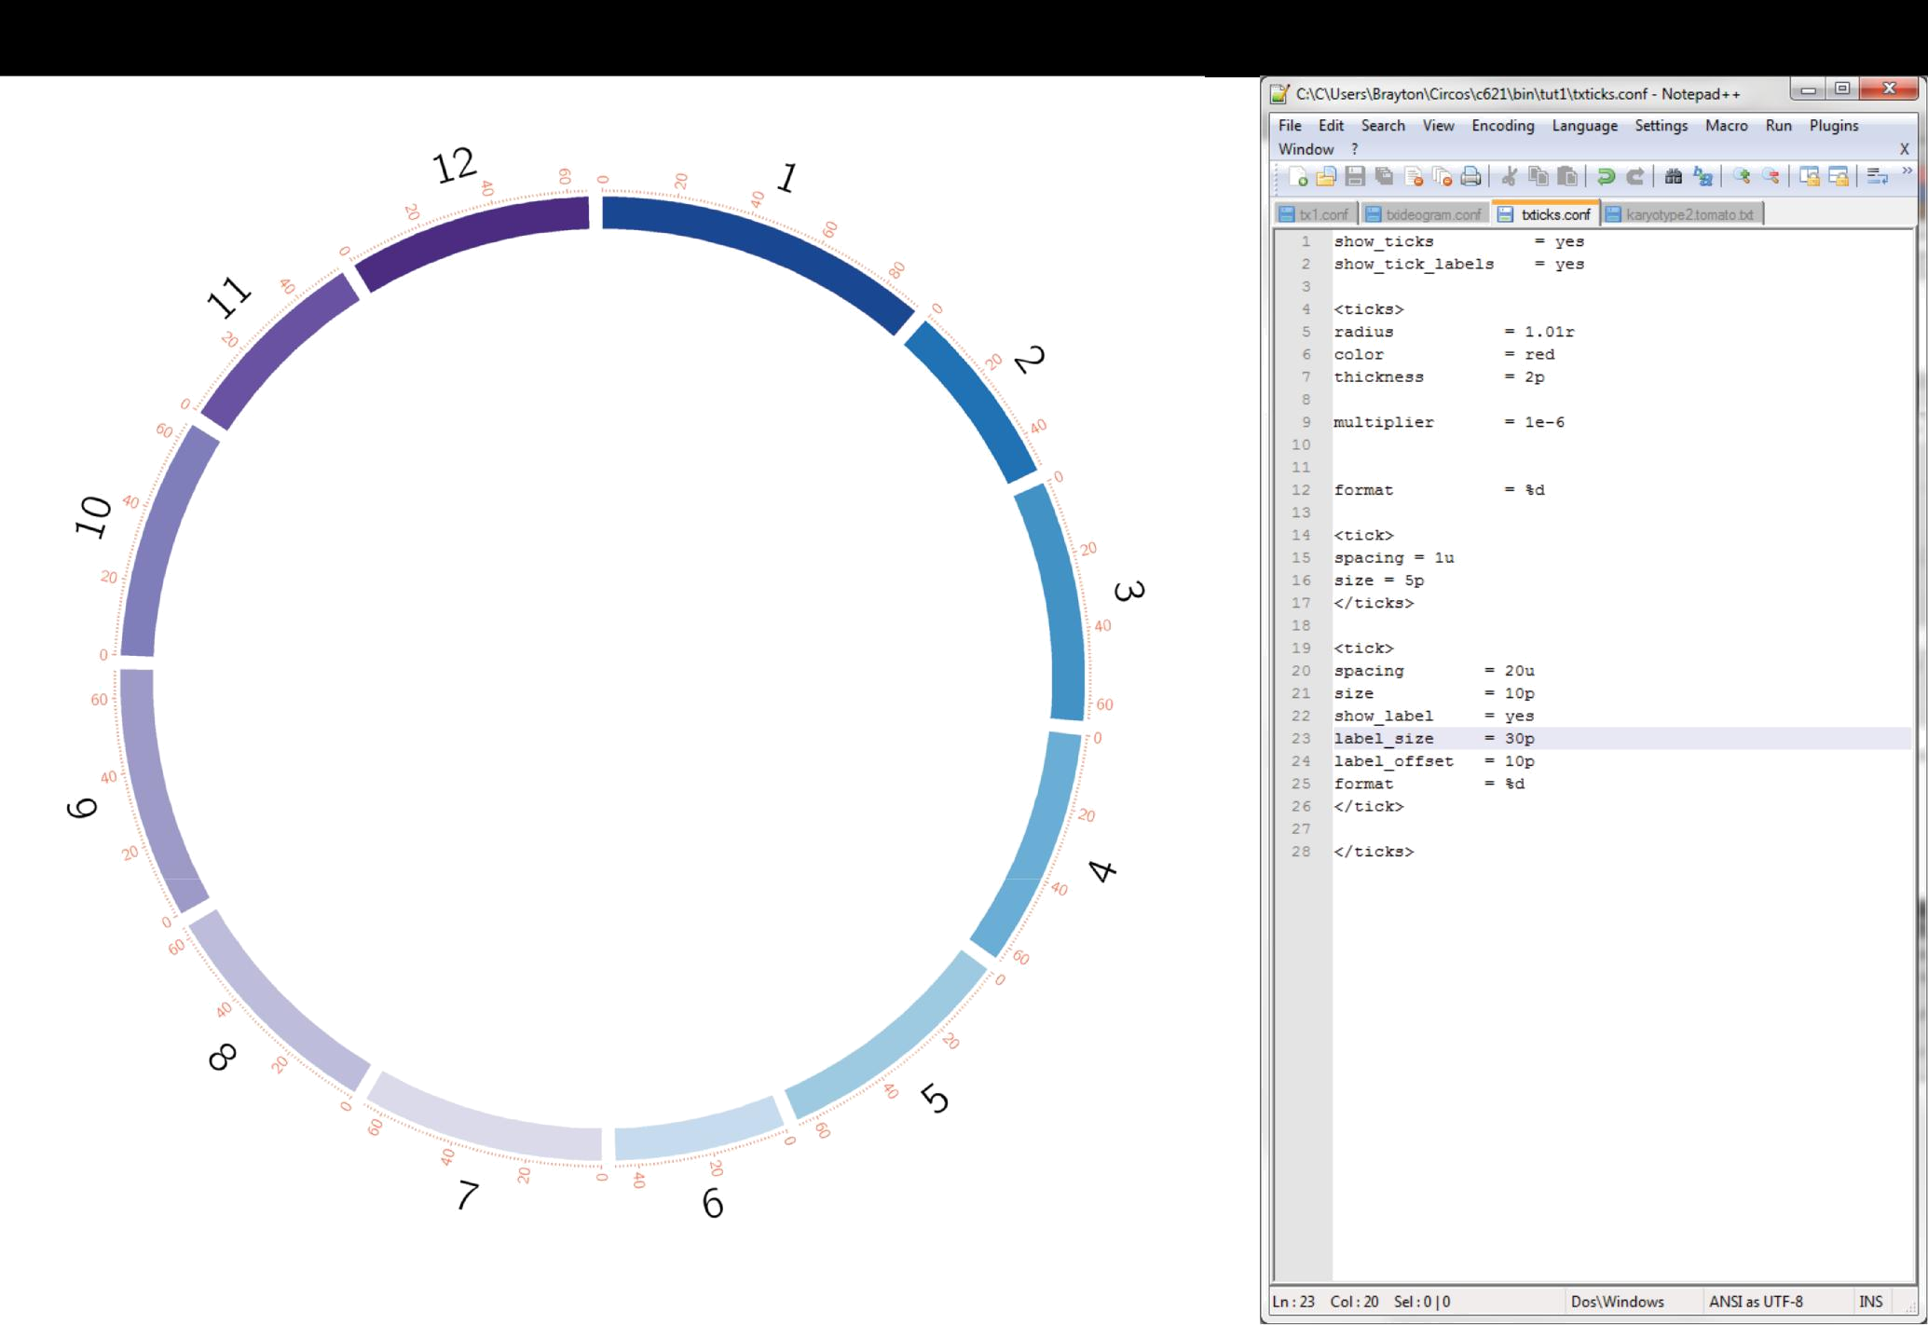
Notes:
Label size of tick
22

Slide 23
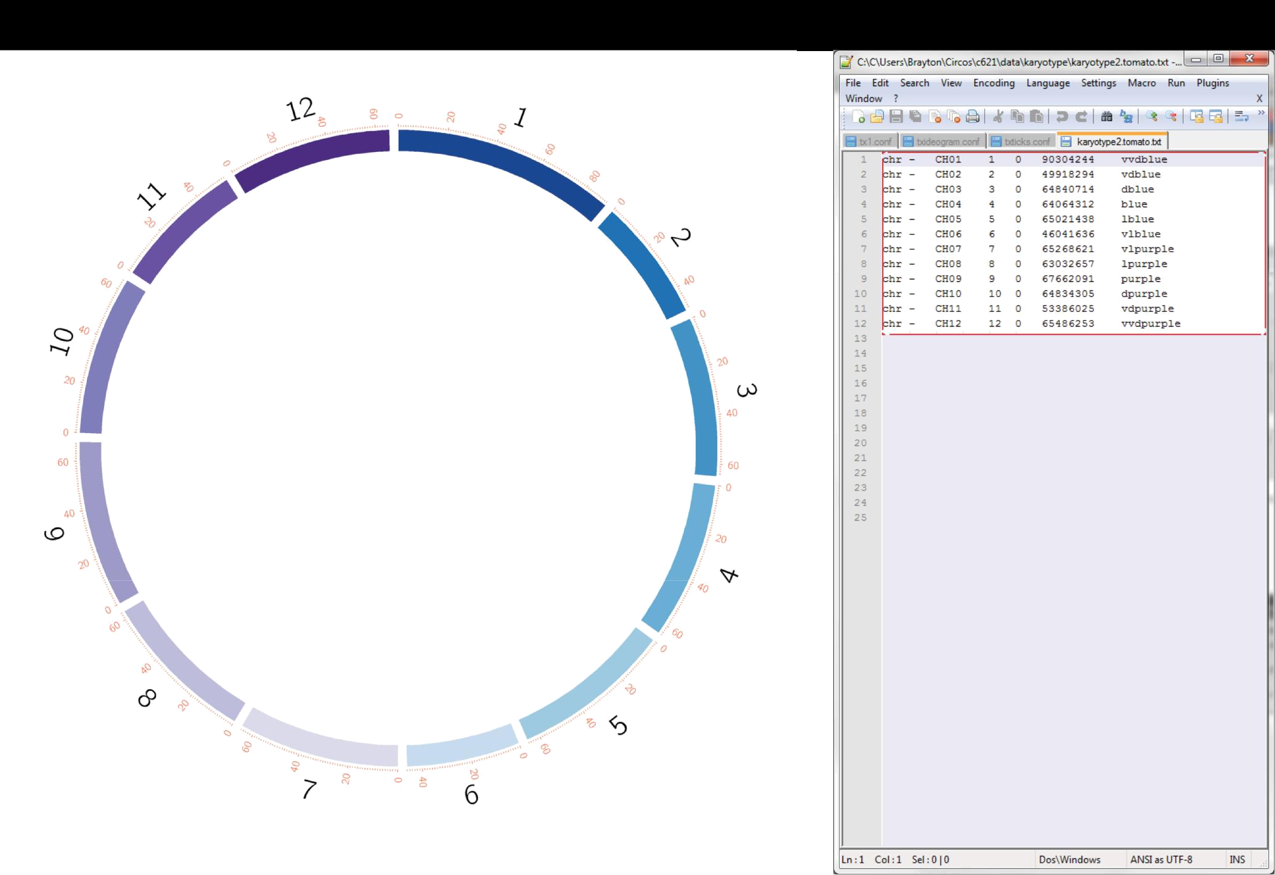
Notes:
karyotype
23

Slide 24
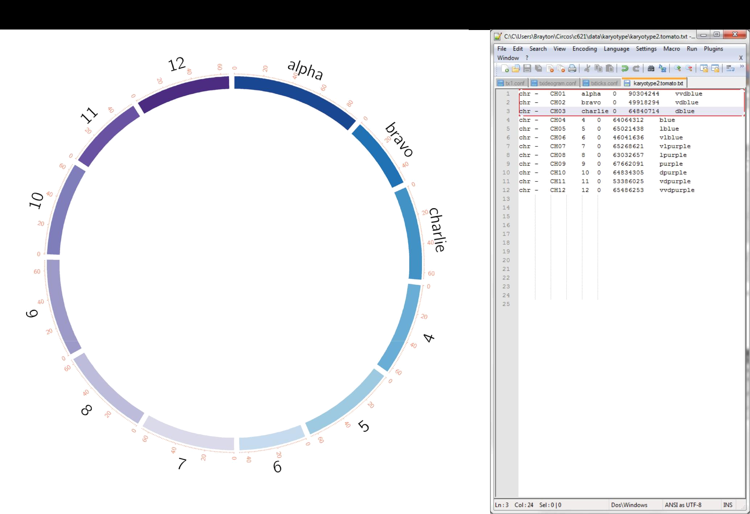
Notes:
Name in the karyotype
24

Slide 25
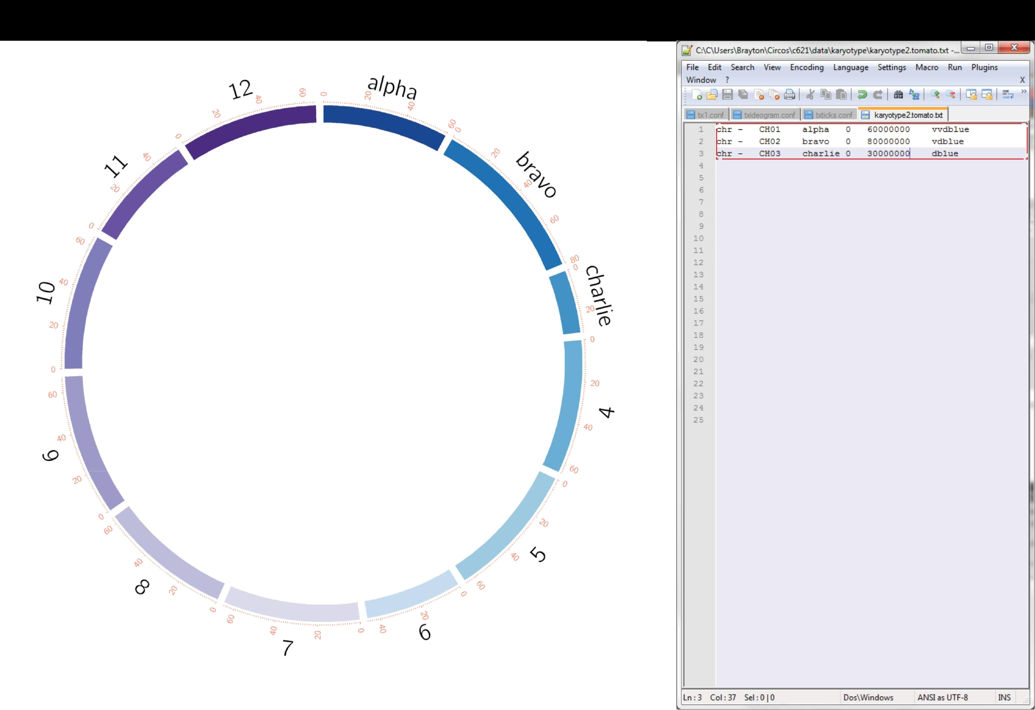

Slide 26
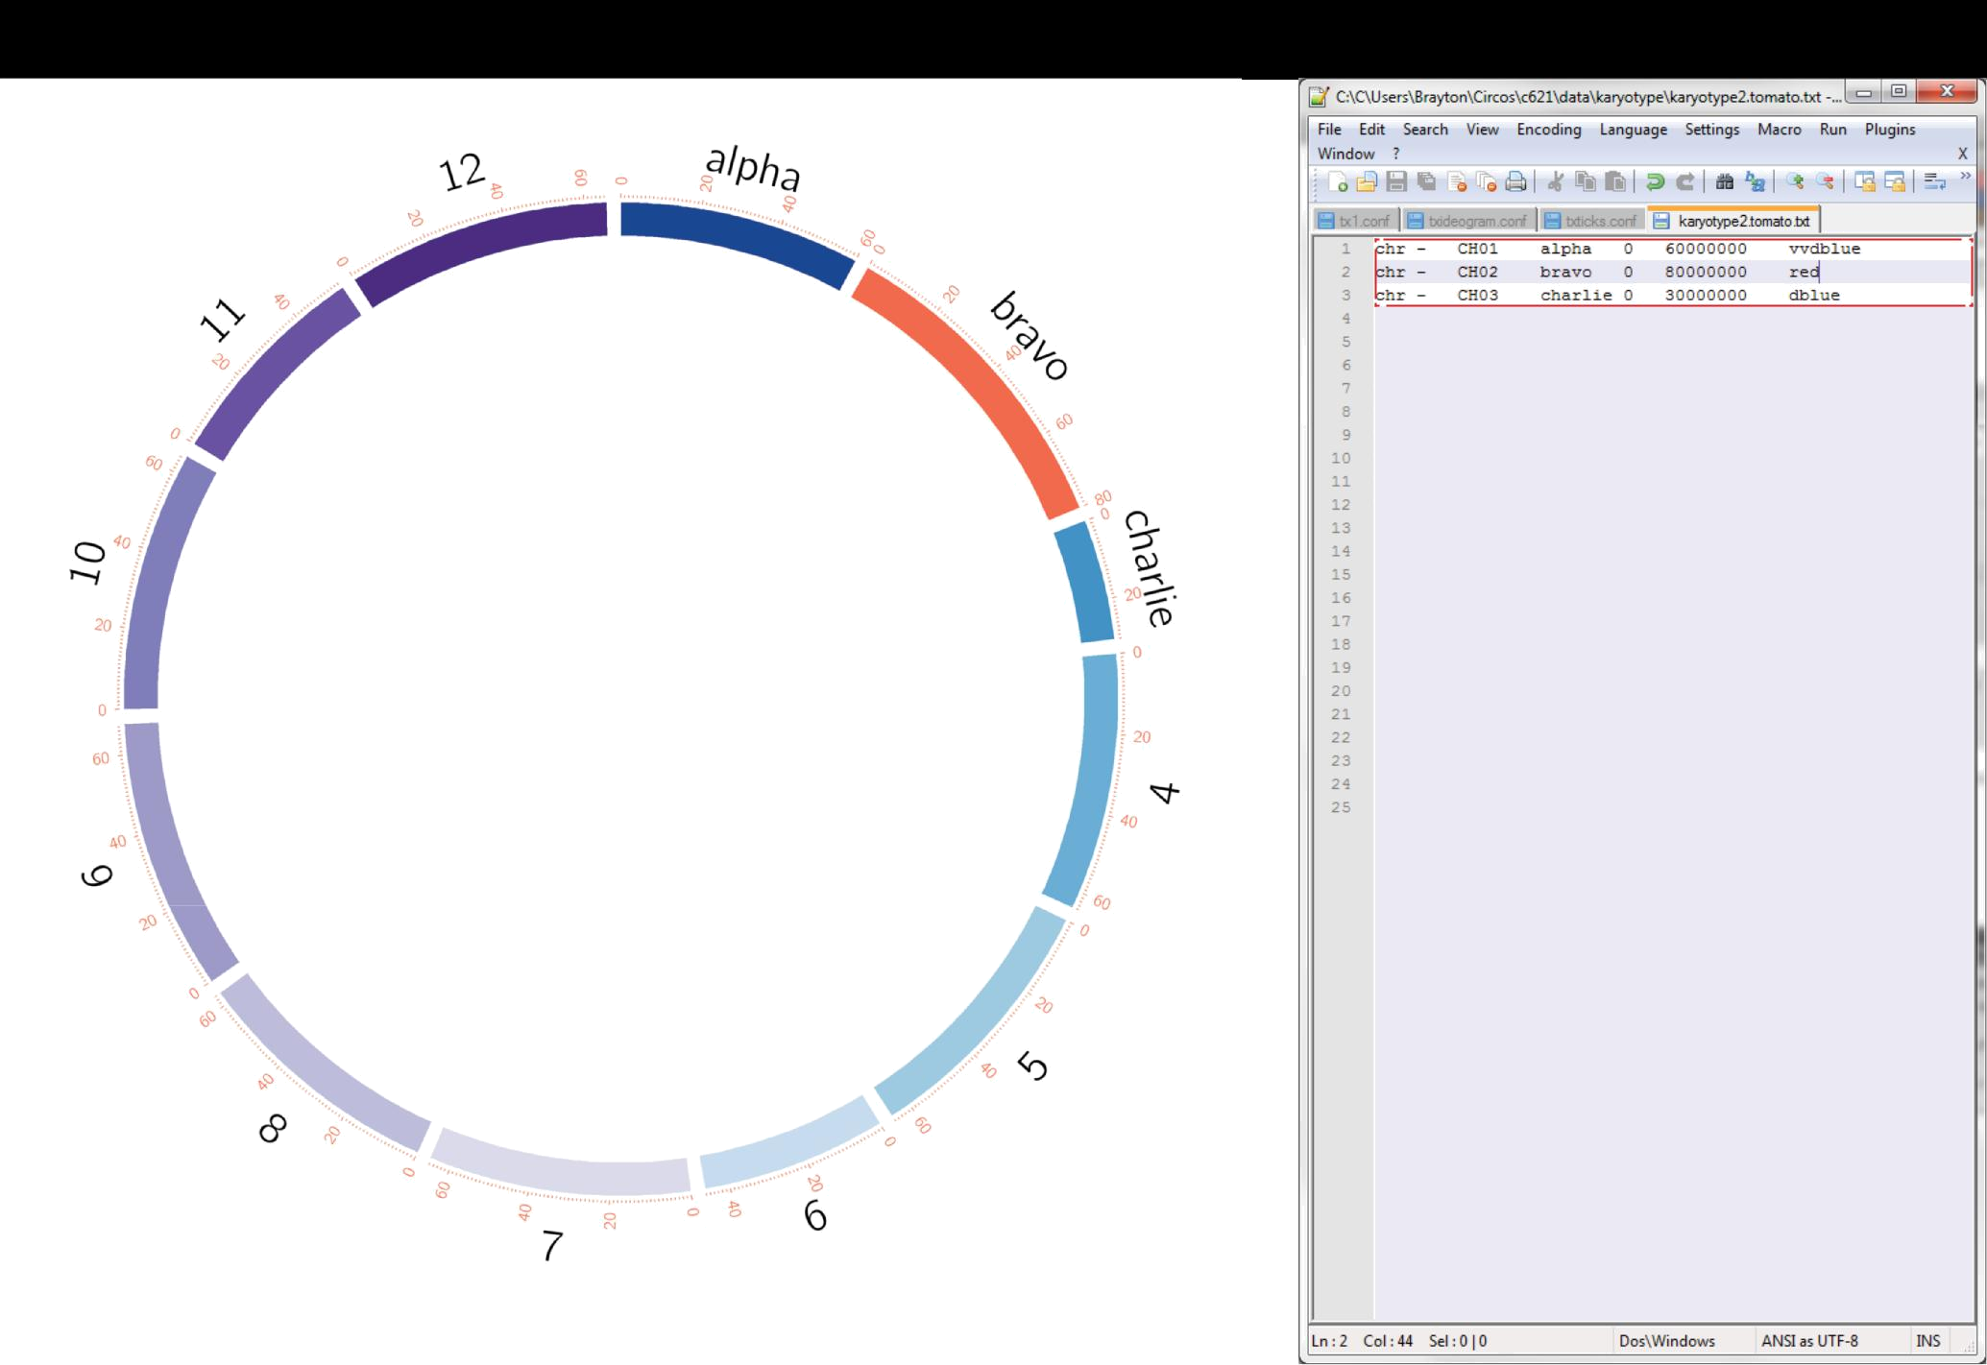
Notes:
Color of karyotype
26

Slide 27
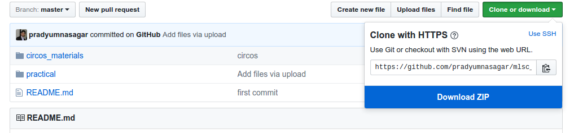
https://github.com/pradyumnasagar/mlsc_bioinfo
Extract the file to a folder
Open terminal and change the directory to the extracted folder
Check the Cicos version installed in terminal type command:
circos -v
Go to practical/1/ folder in terminal

Slide 28
http://circos.ca/
Martin Krzywinski et al. Circos: An information aesthetic for comparative genomics.Genome Res. 2009. 19: 1639-1645
Link: http://genome.cshlp.org/content/19/9/1639
DOI: 10.1101/gr.092759.109

